Slide 1

Department of ECE
ANALOG ELECTRONIC CIRCUIT DESIGN 22EC2104A
CO-2
Session-6 MOSFET biasing

Slide 2





AIM OF THE SESSION
To familiarize students with the biasing of MOSFET
INSTRUCTIONAL OBJECTIVES
This Session is designed to:
Give introduction biasing of MOSFET
To analysis operation of MOSFET in various biasing techniques
LEARNING OUTCOMES
At the end of this session, you should be able to:
1. Describe the working of MOSFET biasing circuits.
2. Demonstrate the operation of MOSFET biaing circuits.

Slide 3
INTRODUCTION
Biasing of a MOSFET (Metal-Oxide-Semiconductor Field-Effect Transistor) involves applying DC voltages to the device terminals to establish the desired operating conditions.
The objective of biasing is to set the MOSFET at a specific operating point, called the bias point or Q-point.
This ensures proper amplification or switching behavior. Biasing is achieved by connecting resistors and voltage sources to the gate and source terminals.
The choice of biasing technique, such as fixed bias, self-bias, or voltage-divider bias, depends on the desired stability, input impedance, and ease of circuit design.
Proper biasing is crucial for MOSFET performance, preventing thermal runaway and ensuring optimal functionality.

Slide 4
MOSFET biasing
As the E-MOSFET operates only in the first quadrant, none of the biasing schemes used with JFETs will work with it.
First, it should be noted that for large signal switching applications biasing is not much of an issue as we simply need to confirm that there is sufficient drive signal to turn the device on.
For linear amplifiers we can use variations on constant voltage bias such as voltage divider bias, or on drain feedback bias.

Slide 5
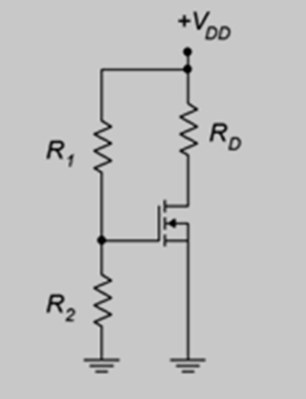
Voltage divider bias
Voltage divider bias is reminiscent of the divider circuit used with BJTs.
Indeed, the N-channel E-MOSFET requires that its gate be higher than its source, just as the NPN BJT requires a base voltage higher than its emitter.
The major differences between the two are that the E-MOSFET's input gate current is negligible compared to base current and that the gate-source voltage will be most likely higher than the 0.7 volt drop seen across the base-emitter junction.
Also, the gate-source voltage will not be locked to a specific voltage but will vary depending on the remainder of the circuit.

Slide 6
Cont…
In general, the layout it is the same as the voltage divider bias used with the DE-MOSFET. The resistors R1 and R2 set up the divider to establish the gate voltage.
As the source terminal is tied directly to ground, this means that V_{GS}=V_{G}.
The potential across R2 needs to be set above V_{GS}(th) for proper operation.
Knowing the value of V_{G} , either the characteristic equation or the corresponding normalized drain current plot can be used to determine the drain current.
The only factor missing is the device constant, k.
This can be computed for any particular device based on the I_{D}(on) , V_{GS}(on) coordinate pair specified in the data sheet.

Slide 7
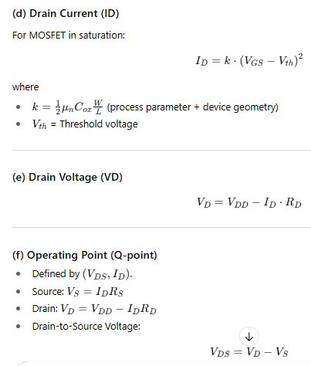
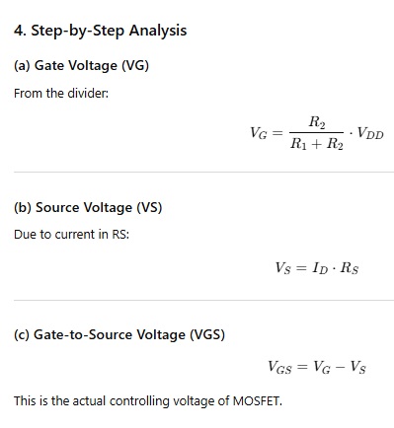


Slide 8
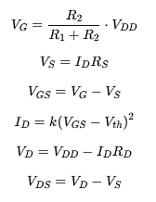

Slide 9
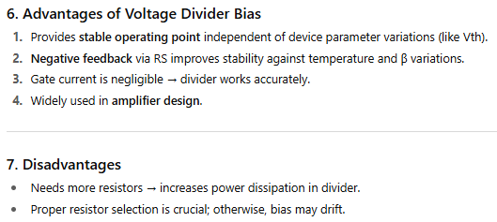

Slide 10
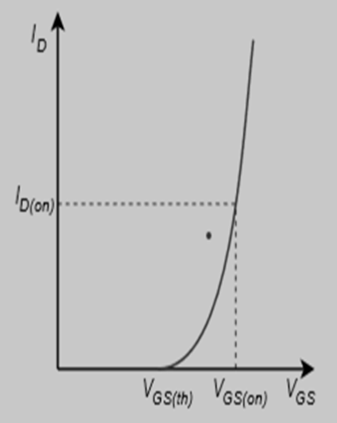
Cont…
The effect of gate voltage on N channel depletion MOSFET
Apply V_{GS} < 0. Holes from the P-type substrate will attract towards the negative gate terminal and recombine with electrons in the N channel, forming electron-hole pairs.
On increasing negative potential at the gate, more electron-hole combinations will occur, decreasing the number of free electrons in the N channel.
As a result, I_{D} decreases. A time will come when the drain current will become zero. The negative gate voltage at which the drain current is zero is called pinch-off voltage or VP.
We can conclude from this discussion at pinch-off, V_{GS} = V_{P}, V_{DS} > 0, and I_{D} = 0, as shown in the figure below.

Slide 11
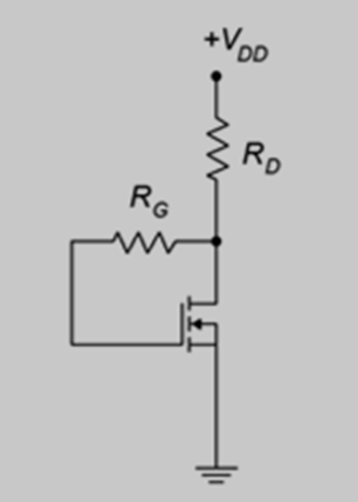
Drain feedback bias
In this method of biasing, the gate is connected to the drain through a high-value resistor (RG). Because the MOSFET gate current is practically zero, the gate and drain voltages become equal (VG​=VD​). The circuit requires fewer resistors compared to voltage divider bias and offers self-adjusting stability.
Drain feedback bias utilizes the aforementioned “on” operating point from the characteristic curve. The idea is to establish a drain current via an appropriate selection of the drain resistor and power supply. The prototype of the drain feedback circuit is shown in Figure.
This is relatively simple layout using few components. The key to understanding its operation is the KVL summation:
V_{DD}=V_{RD}+V_{RG}+V_{GS}
V_{DD}=I_{D}R_{D}+I_{G}R_{G}+V_{GS}
Gate current is negligible which means that
V_{DD}=I_{D}R_{D}+V_{GS} and also
V_{DS}=V_{GS}
Therefore,
V_{GS}=V_{DS}=V_{DD}−I_{D}R_{D}

Slide 12
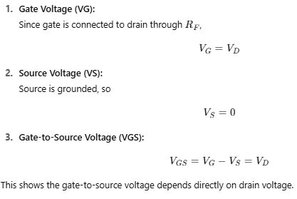

Slide 13
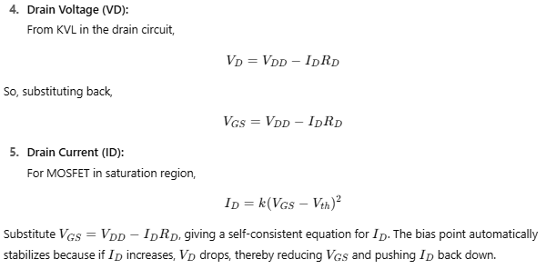

Slide 14
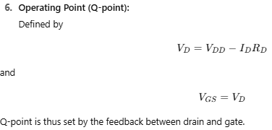

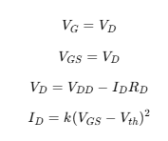

Slide 15
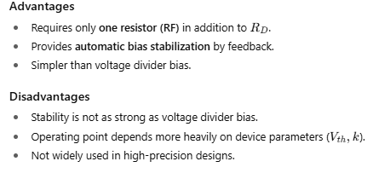

Slide 16

SUMMARY
Biasing of MOSFETs is the process of establishing the desired operating conditions for the device by applying DC voltages to its terminals.
The purpose of biasing is to set the MOSFET at a specific operating point, known as the bias point or Q-point, which ensures optimal amplification or switching behavior.
Different biasing techniques, such as fixed bias, self-bias, or voltage-divider bias, are employed depending on factors like stability, input impedance, and circuit design simplicity.
Proper biasing is crucial to prevent thermal runaway and maintain optimal performance. Resistor networks are commonly used in biasing circuits to control the gate and source voltages.
By carefully selecting the biasing parameters, the MOSFET can operate reliably and efficiently in various applications.

Slide 17
SELF-ASSESSMENT QUESTIONS
1. The purpose of a coupling capacitor in MOSFET biasing is to:
a) Block DC voltage
b) Amplify the input signal
c) Stabilize the bias point
d) Increase the voltage swing
2. The gate bias voltage in MOSFET biasing should be within the:
a) Threshold voltage range
b) Breakdown voltage range
c) Saturation voltage range
d) Cutoff voltage range

Slide 18
TERMINAL QUESTIONS
1. Explain the concept of biasing in MOSFETs and discuss the different biasing techniques used.
2. Discuss voltage divider bias configuration of MOSFET

Slide 19
REFERENCES FOR FURTHER LEARNING OF THE SESSION
Reference Books:
1. Jacob Millman - “Electronic Devices and Circuits”, 4th Edition, McGraw Hill Education (2015)
2. D Roy Choudhury and Shail B. Jain – “Linear Integrated Circuits”, 4th Edition, New Age International Pvt.Ltd. (2017)
3. David A. Bell - “Electronic Devices and Circuits”, 5th Edition, Oxford University Press (2008)
Sites and Web links:
https://www.learnelectronicswithme.com/2020/07/what-is-jfet-construction-and-working.html
https://electronicspost.com/explain-the-construction-and-working-of-a-jfet-what-is-the-difference-between-a-jfet-and-a-bjt/
https://electronicsdesk.com/junction-field-effect-transistor.html

Slide 20
THANK YOU
Team – ANALOG ELECTRONIC DEVICES AND CIRCUITS

